Slide 1
Tēnā Koutou and Kia Ora
LONGVIEW
Marinus John William Tahu | Spring Symposium 2018 | Information Systems Management

Slide 2
LONGVIEW
Overlook
1. Over Look 2. End Goal 3. Inspiration 4. Design 5. Tool Set 6. Investments And Returns | 7. The Back-End 8. The Front-End 9. Work-Flow 10. Future Extensions 11. Feed Back Loop 12. Resources
Marinus John William Tahu | Spring Symposium 2018 | Information Systems Management

Slide 3
End Goal
A Single Central Interface To Gather All Three Time-Bound Views
Allowing The Cross-Referencing Of Unstructured Data
LONGVIEW
Marinus John William Tahu | Spring Symposium 2018 | Information Systems Management

Slide 4
Inspiration
Future Shock – Toffler
Clear Desk Theory
Urgency-Importance Matrix
LONGVIEW
Marinus John William Tahu | Spring Symposium 2018 | Information Systems Management

Slide 5
Design
Considerations
Platform Agnostic
Adaptable
LONGVIEW
Marinus John William Tahu | Spring Symposium 2018 | Information Systems Management

Slide 6


Tool Set
LONGVIEW
MS Access An easy to deploy stand-alone database management system | MS Visual Basic A Rapid Prototyping Development Language
Marinus John William Tahu | Spring Symposium 2018 | Information Systems Management

Slide 7
Investments And Returns
Database Back-End
Costs-And-Benefits
A
Desktop Design
LONGVIEW
Marinus John William Tahu | Spring Symposium 2018 | Information Systems Management

Slide 8
The Back-End The Database Model
LONGVIEW
Marinus John William Tahu | Spring Symposium 2018 | Information Systems Management

Slide 9
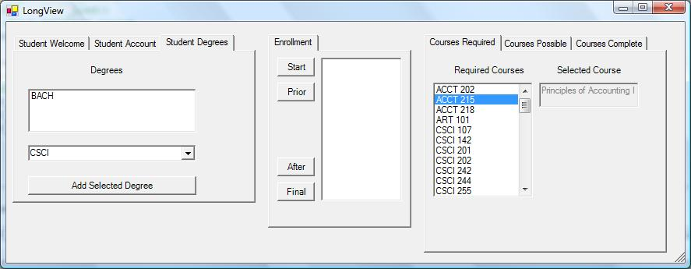
The Front-End GUI Interface
LONGVIEW
Marinus John William Tahu | Spring Symposium 2018 | Information Systems Management

Slide 10
Work-Flow
LONGVIEW
Marinus John William Tahu | Spring Symposium 2018 | Information Systems Management

Slide 11
Future Extensions
LONGVIEW
Quantitative | Qualitative
Course Offerings Frequency And Weight | Course Topic Interest And Familiarity
Marinus John William Tahu | Spring Symposium 2018 | Information Systems Management

Slide 12
Feed Back Loop
Marinus John Tahu
Tahu.Marinus@gmail.com
LONGVIEW
Marinus John William Tahu | Spring Symposium 2018 | Information Systems Management

Slide 13
Resources
LONGVIEW
SQL For Mere Mortals ~ Viescas And Hernandez | Inspired vision of the future that is becoming more yesterday, than tomorrow | Visual Basic Net 2003 ~ Halvorson
Building layer-upon-layer of very-simple to very-complex databases and relationships | Future Shock ~ Toffler | From the floor to the ceiling guide to building function application in Visual Basic
Marinus John William Tahu | Spring Symposium 2018 | Information Systems Management

